Slide 1

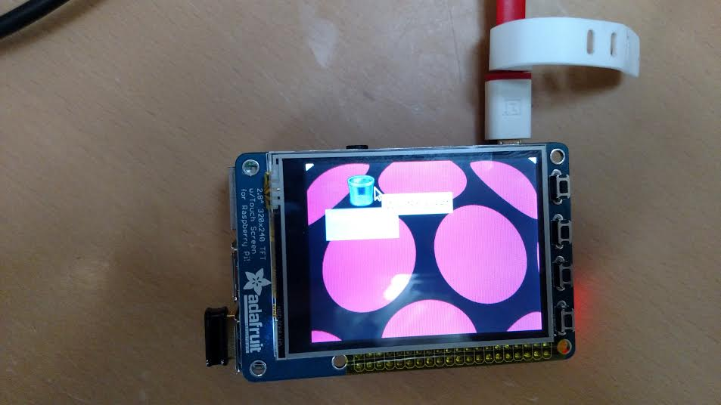

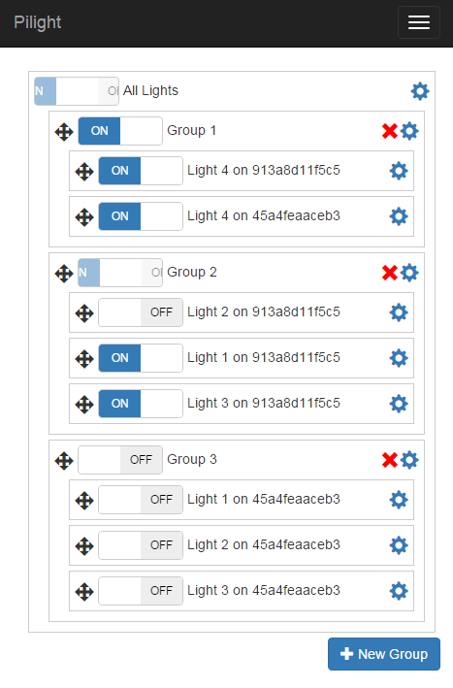
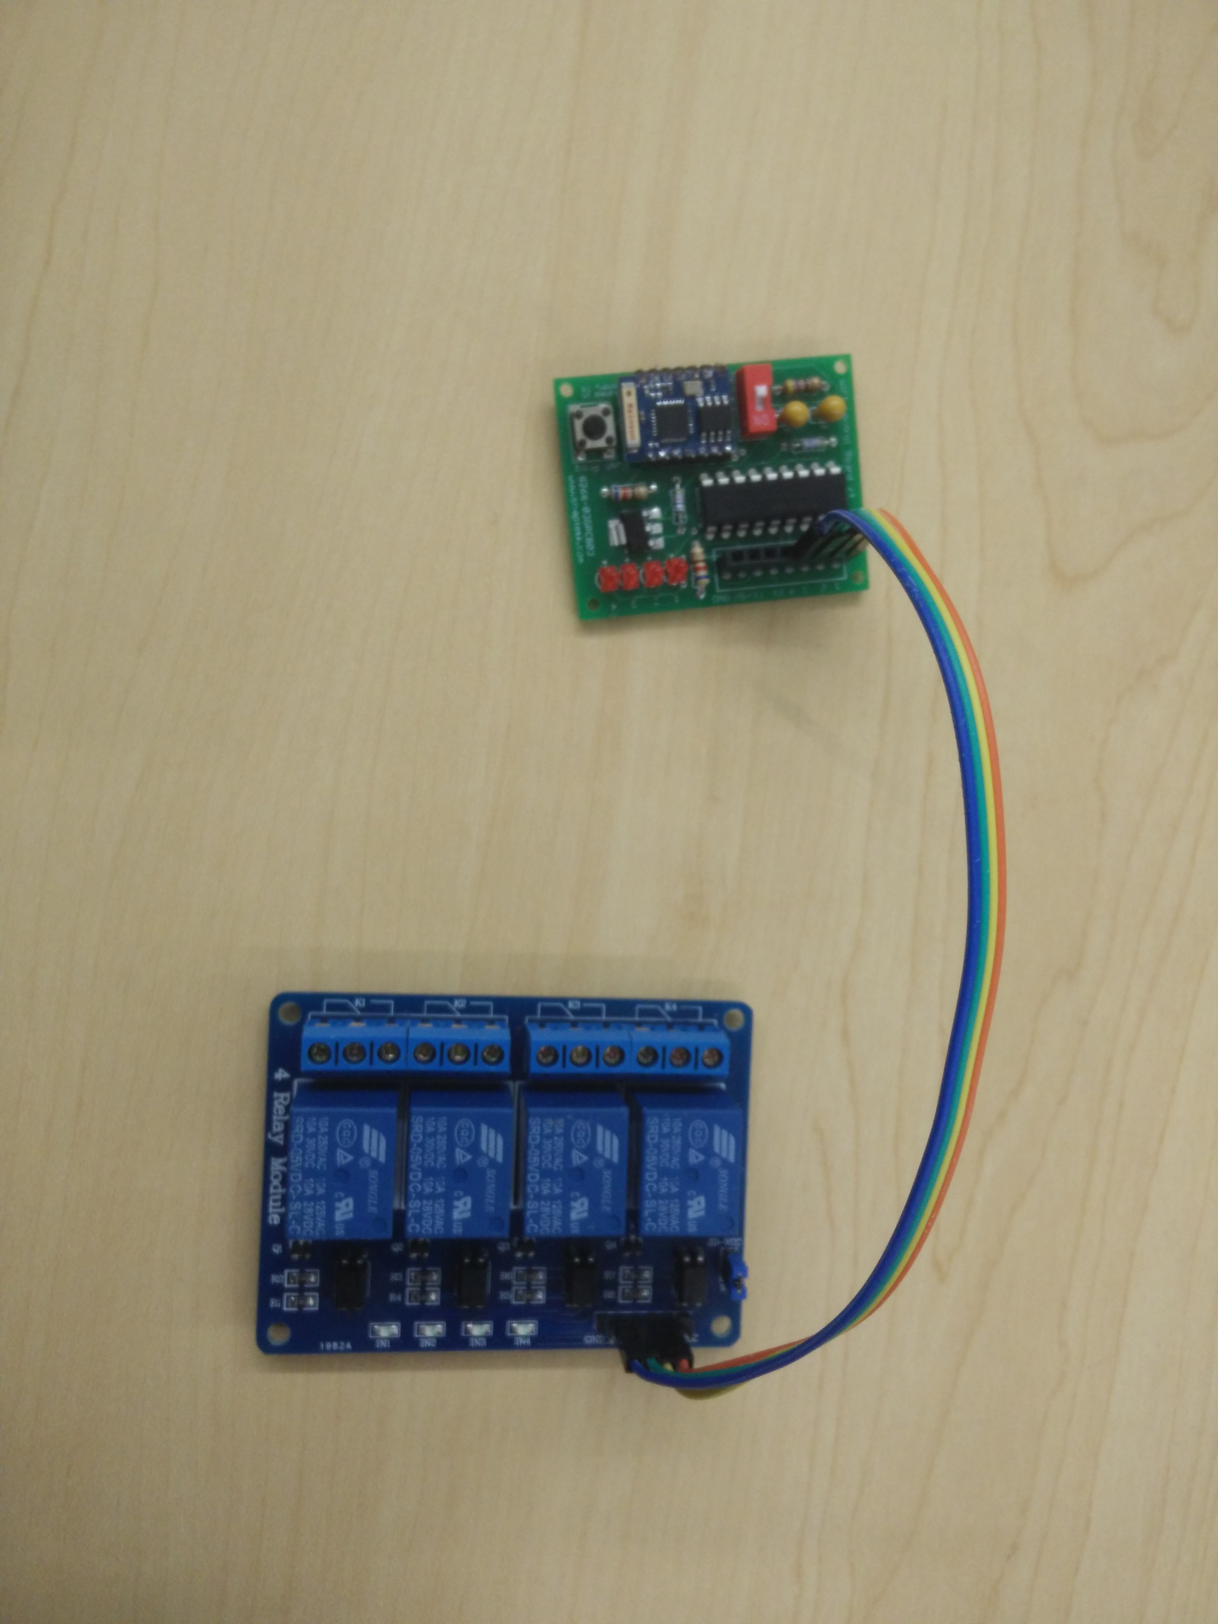
Approach Taken
Our primary goal for the project was ease of use, so we knew having a full-color touch interface for controlling the lights was imperative. Additionally, to negate the need to run wires throughout the house, we created our devices to communicate wirelessly. Naturally, a central control unit that connects wirelessly to the devices is the way to go. Users can plug their lights into the relays, plug it into the control unit, press the pairing button, and the control unit will broadcast a wifi signal to connect to each device. From there we can control each device with a series of rules.
PiLight
Not Exactly the Internet of Things for Outdoor Lighting
CS CAPSTONE PROJECT TEAM 22
Solution Implemented
Plug lights into one or more devices
Connect the devices to power
Connect the control unit to power and press the “pair” button
All components automatically connect wirelessly
Control unit has touchscreen controls for toggling lights
Control unit can also be controlled from phone, laptop, etc.
Lights can be set to toggle on/off at specified times.
Lights can be set to toggle at sunset/sunrise automatically
Open source software
Inexpensive, easy to use, extensible
TEAM MEMBERS
Malcolm Diller (dillerm@oregonstate.edu)
Sean Rettig (rettigs@oregonstate.edu)
Evan Steele (steelee@oregonstate.edu)
PROJECT ADVISOR
Victor Hsu (hsuv@oregonstate.edu)
PROJECT SPONSOR
OSU
Touchscreen on Raspberry Pi (control unit)
Project Description
The options on the market today for home outdoor lighting control are less than ideal. You can either pay out the nose for an overly complex fancy system, or be stuck with a cheap system that needs constant reprogramming for the changing sunset/sunrise times.
Our goal is to split the difference by providing a solution that is both easy to use and affordable. The solution includes a central control unit with touchscreen for controlling lights, a web site for controlling the entire system from a phone, laptop, tablet, or other device, and devices to plug lights into that communicate with the central control unit wirelessly.
Running on commodity hardware and open source software, the system will be easy to extend to other applications as well, such as garage door openers, sprinkler systems, and more!
Solutions Considered
The ESP8266 modules act as clients in our network, connecting to the Raspberry Pi host. The web app supports adding new devices through a pairing system, even with multiple hosts. We considered using an ad-hoc network for connections among other network layouts, but the client-host model proved optimal for our hardware.
We also considered building the web site with PHP, but in the end, decided to go with Python as we were also using it in the modules.
Results and Recommendations
Much of the testing required integration tests in order to verify that the lights, plug nodes, control node, and user interface interact together correctly.
We tested our system's capabilities to handle long distance communication, large amounts of clients, and any interference from other nearby systems.
Our work has resulted in a low-cost way to implement home automation for lighting systems.
User Interface
The green ESP8266 module connected to a blue 10A 4-switch relay
Notes:
<number>

